Slide 1


Team 28: Gas Monitoring System
Bi-Weekly Update 1 Matthew Owen, Joaquin Salas, Blake Schwartzkopf, Tanmay Sarkar Sponsor: Justin Houck TA: Vishwam Raval
Notes:
Michelle

Slide 2
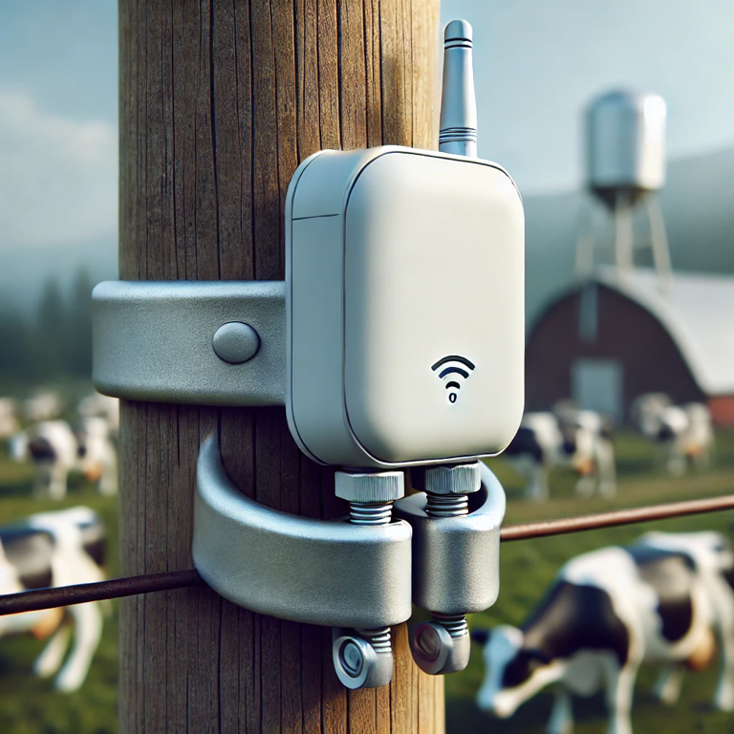
Project Summary
Monitoring environmental conditions in animal farms.
To design and implement a durable, real-time gas monitoring system that can track harmful gases in animal farms.
Picture / Diagram here
Notes:
Kyle

Slide 3
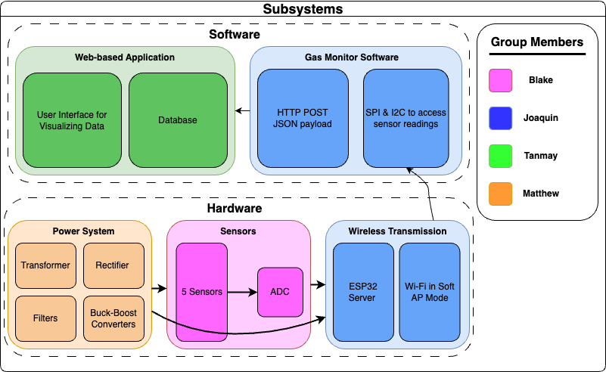
Project/Subsystem Overview
Notes:
Eric

Slide 4
Major Project Changes for 404
Sensor subsystem now need an additional voltage of (7-18)V, which was not previously outlined in 403
New voltage to satisfy max range for op amp supply voltage
Changes are being made to power subsystem to satisfy new requirements
Notes:
Eric

Slide 5
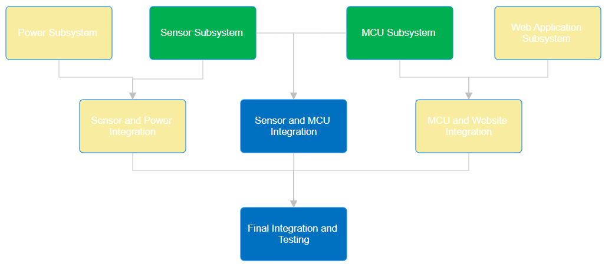
Project Timeline
High level figure showing where you are at in the project, what’s completed, what’s underway – it should take about 30 seconds to summarize where you are in the timeline
-- Save discussion for subsystem update
-- Save detail for execution plan & validation plan status
Green - Finished
Yellow - Ongoing
Blue - Not started
Notes:
Eric

Slide 6
Power Subsystem
Matthew Owen
Accomplishments since 403 ~22 hrs of effort | Ongoing progress/problems and plans until the next presentation
Soldered a entire new pcb to correct issues faced in 403 Identified and fixed issues with resistor values on voltage dividers Fixed the issue that the voltage couldn't handle the full load required | Fix the inverter circuit to get the 5V from the 5V Begin to integrate my pcb with sensor pcb, making sure the power is sufficiently supplying all load necessary in sensor pcb.

Slide 7
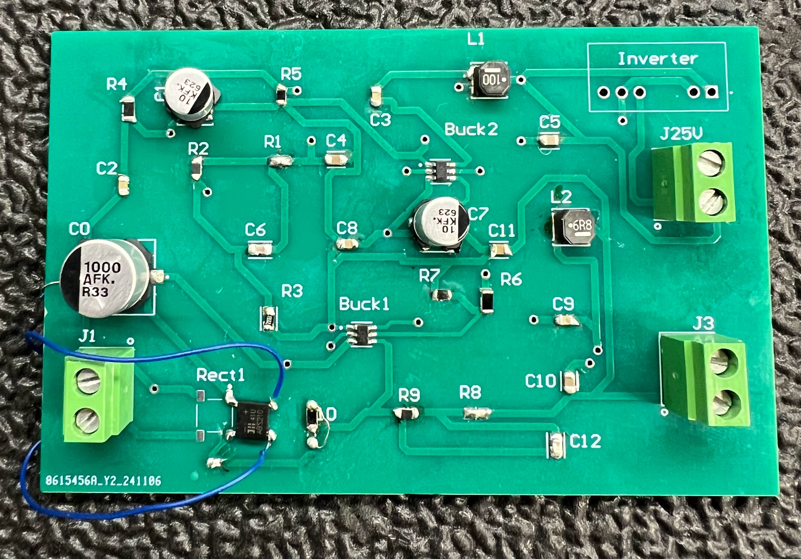
Power Subsystem
Matthew Owen
New PCB is working as designed except for inverter circuit. I am correctly output all necessary voltages and have tested all output to perform under load higher than I expect to ever be necessary.

Slide 8
Sensor Subsystem
Blake Schwartzkopf
Accomplishments since 403 30 hrs of effort | Ongoing progress/problems and plans until the next presentation
Problems with voltage divider, I2C hardware, and SPI hardware diagnosed. New board designed over break. More compact. New board soldered. New board validated. All problems from 403 resolved. | Integration with MCU subsystem. Integration with power subsystem.

Slide 9
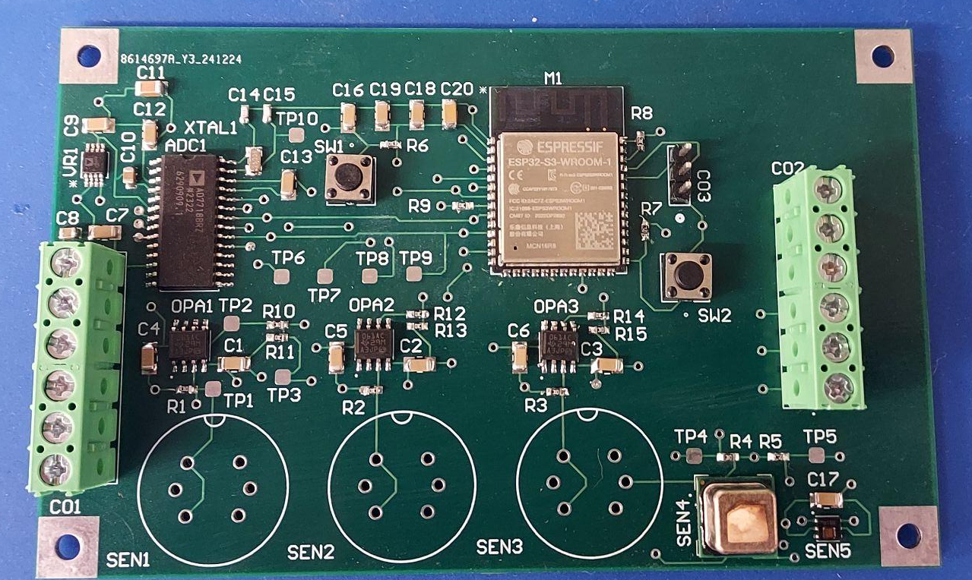
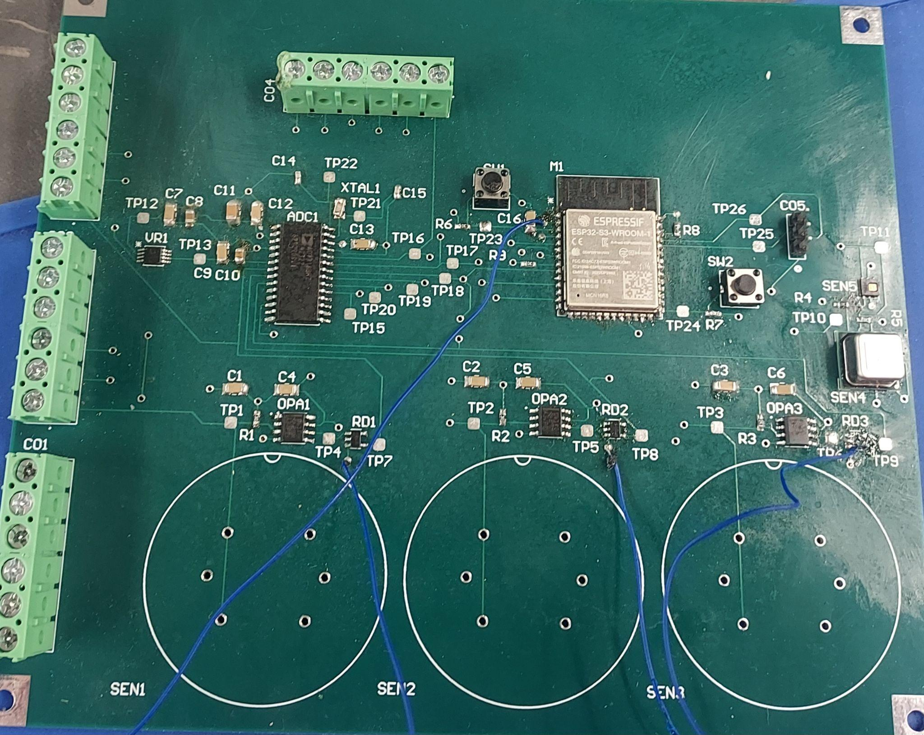
Sensor Subsystem
Blake Schwartzkopf
Old
New

Slide 10
MCU & Data Transmission
Joaquin Salas
Accomplishments since 403 10 hrs of effort | Ongoing progress/problems and plans until the next presentation
Subsystem works as demoed in 403 Ran into an issue where every 4 transmissions were corrupted (Fixed) Tested Bluetooth, stayed with Wi-Fi for ease of use, reliability, and transmission range | Integrating with Database and Web Application Subsystem Setting ESP32 as HTTP server to allow HTTP POST requests from database Code written, does not work, stuck in infinite loop Debug and work with Tanmay

Slide 11
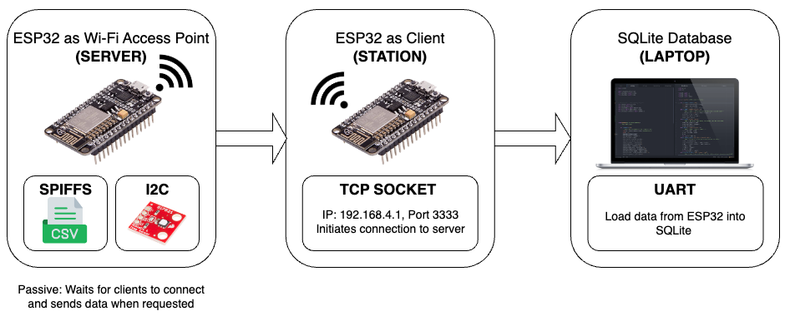
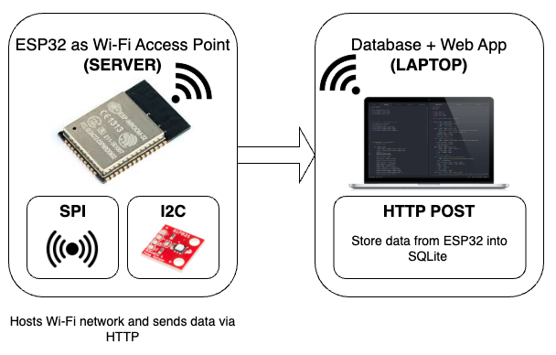
MCU & Data Transmission
Joaquin Salas
ECEN 403 (Old Setup)
Unnecessary intermediate
Requires 2 MCU’s and hard wired connection
ECEN 404 (Proposed Setup)
ESP32 -> Sends JSON sensor data to the laptop’s HTTP server via HTTP POST

Slide 12
Web Application + Database Subsystem
Tanmay Sarkar
Accomplishments since 403 | Ongoing progress/problems and plans until the next presentation
AWS Database + Locally hosted web application back up and running. | Ongoing: Adding password protection + 2FA for more security Begin integrating with Joaquin’s MCU subsystem - Goal: Finish integrating 3 weeks from now

Slide 13
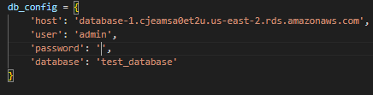
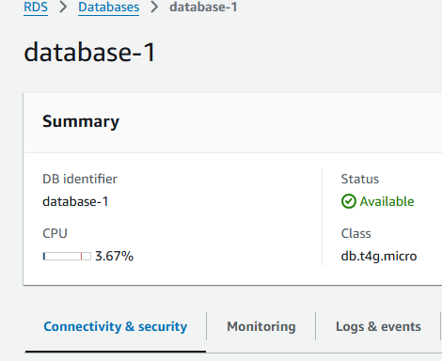
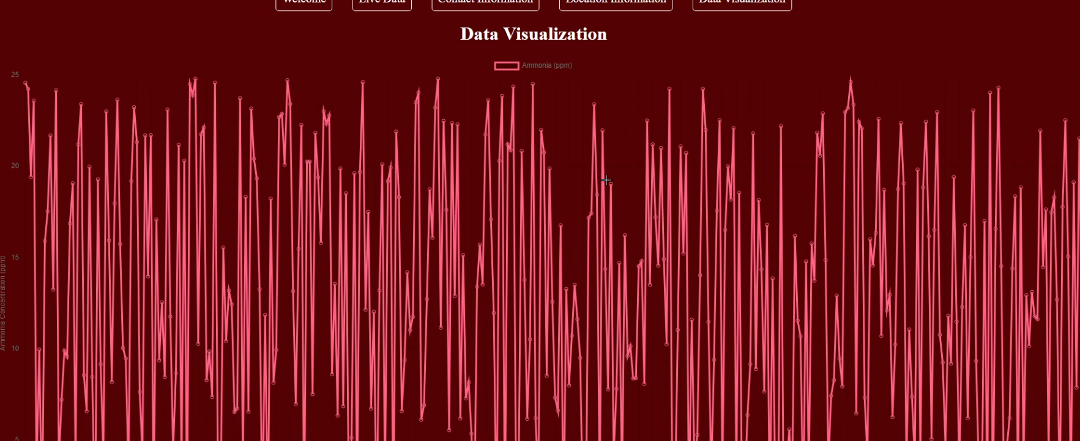
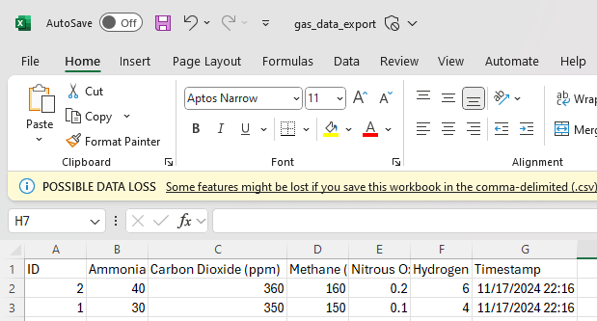
Web App + Database Subsystem Accomplishments
Database hosted on AWS
Database secured by password protection
Graphing of all gas data
Export to CSV

Slide 14
Parts Ordering Status
Capacitors, MCU, and headers ordered and received for sensor subsystem.
Notes:
Michelle

Slide 15
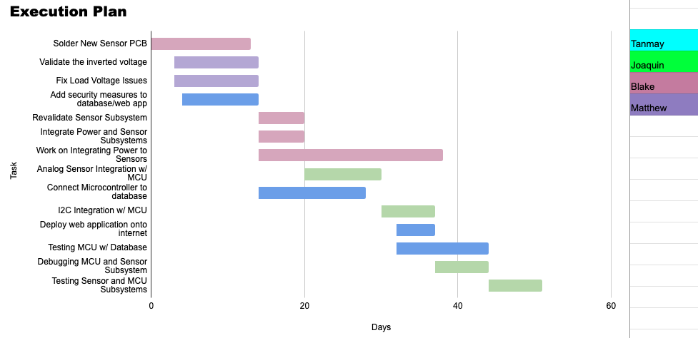
Execution & Plan
Execution plan
Your team planned milestones for completion of any remaining subsystem functionality, integration of specific subsystems, test, and validation plans should be presented.
Milestones should have owners … things like final integration can be group owned
Gantt chart – should indicate some 404 progress.
Try to complete all subsystem function in next 3 weeks.
Try to complete all integration 2 weeks before demo to allow for system validation and documentation
Pink - Blake
Purple - Matthew
Blue - Tanmay
Green - Joaquin
Notes:
Michelle

Slide 16
Questions?

